Slide 1


In the Name of ALLAH, the Most gracious, the Most Merciful

Slide 2
Augmented Reality Shooting Game
Supervised by:
Muhammad Kamran
Group Members:
Muhammad Usman (FA17-BSE-037)
Muhammad Adnan Abid (FA17-BSE-003)
Department of Computer Science
COMSATS University Islamabad, Attock Campus

Slide 3
Outline
Introduction
Working flow
Problem statement
Objectives
Methodology
Modern tools
Benefits
References

Slide 4
AR Shooting Game is an augmented reality-based game. Augmented Reality is a term for real environment whose elements are augmented by computer generated information. By using this technology in your android phone, you can imagine the player in real space while playing this game.
Introduction
In AR Shooting Game, we are using Simple State Machine Artificial Intelligence

Slide 5
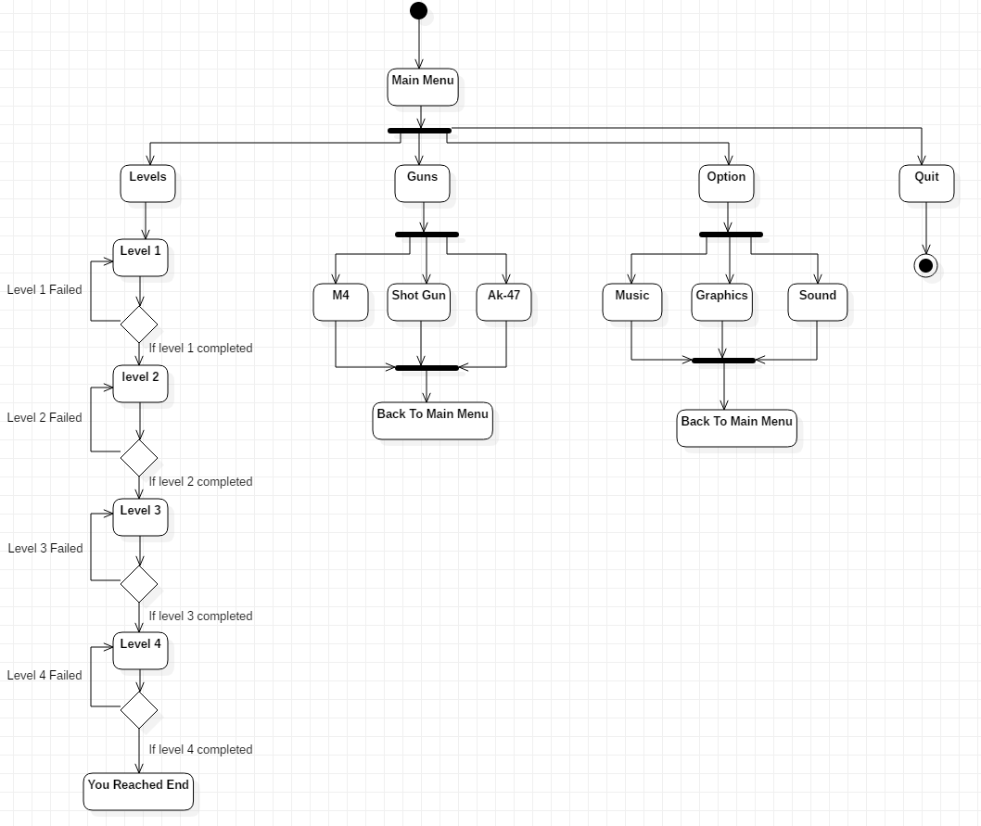
Working Flow

Slide 6
Problem statement
There is some AR shooting game available but it does not meet the user satisfaction. They have different problems like buying of asset’s, controls, audio, Sign in, unavailability of asset’s, less modes, poor design, crashing, login, connection error, lack of information, help, compatibility with android, record maintenance, levels etc. we’ve been witnessing in our country, game development is still not as popular in Pakistan. It is not considered as a serious career path or as something that could help the industry and get recognition for the country. It is not given the same type of importance as other development fields and areas in the country.

Slide 7
Objectives
Our game has real environment
Our game solves those problems which are in existing games i.e. buying of assets, controls etc.
Our game detect ground.

Slide 8
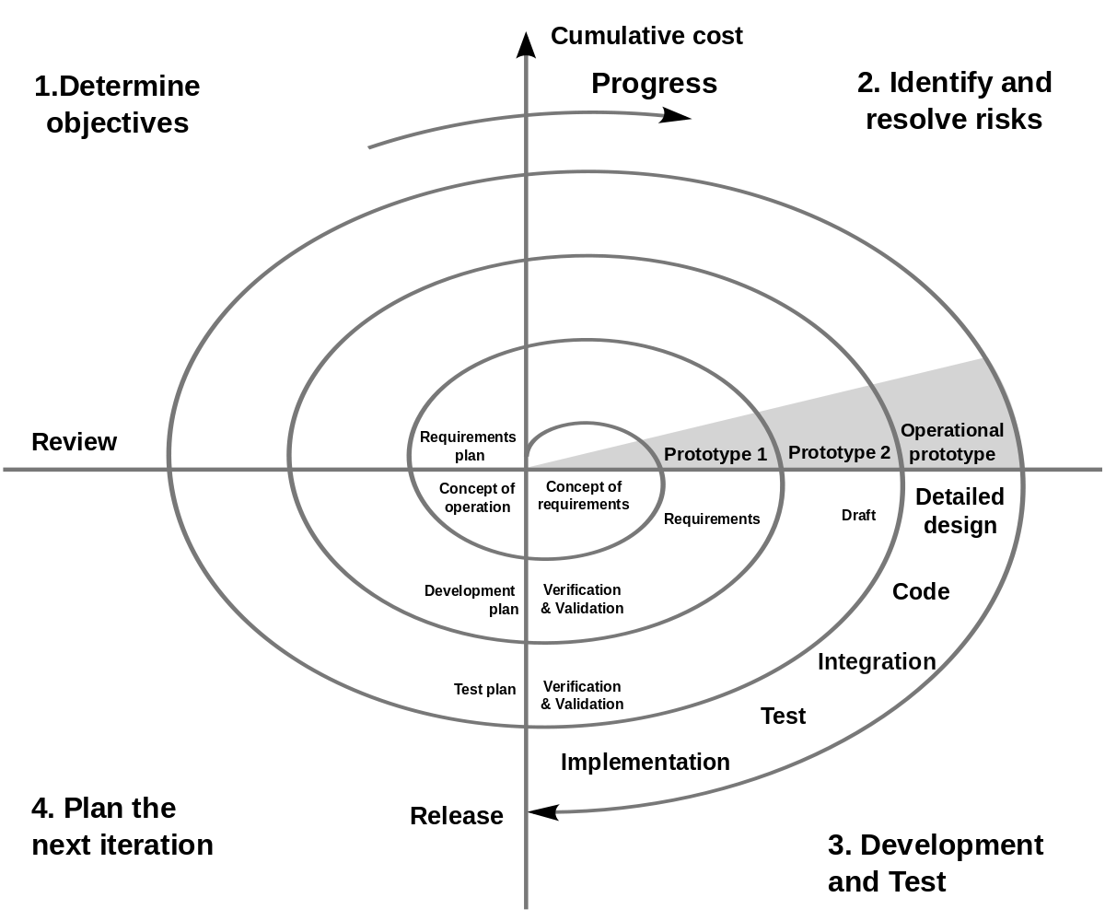
Methodology
Spiral Model

Slide 9
Methodology
So in this project, we are following the spiral as the methodology. We were not wrong if we say the spiral model combines both the iterative and the waterfall process models. One thing in the spiral model makes it different from all other named risk analysis. Risk analysis is the technique in which we can determine the risk by examining the time estimation, cost estimation, the feasibility of the things, etc.

Slide 10
Development Requirements
Hardware Requirements :
PC for Development : MS Windows 10, CPU
(Core i5), Hard Disk 512GB, Ram 4GB
Android Phone : Nougat (7.0) or later version
Resolution of Display : 1280 * 1024 with 16-bit color
Software Requirements :
Blender : 3D Modeling(animation), Visual Effects
Unity 3D (version 2017 or Above) : Mobile Application Development
AR Core : Use for Augmented Reality
C Sharp : Programming languages for Scripting

Slide 11
Modern tools
Tools | Version | Rationale
Blender | 2.90.0 | 3D Modeling Tool
Unity 3D | 2018.4.5 | For Development
AR Core | 1.19.20210084 | Augmented Reality Application
C Sharp | 2013 | IDE

Slide 12
Benefits
Through AR technology users can interact with real world in real time.
Due to AR technology, information become more realistic.
With the help of AR technology, life’s activities become easy and fun.

